Slide 1
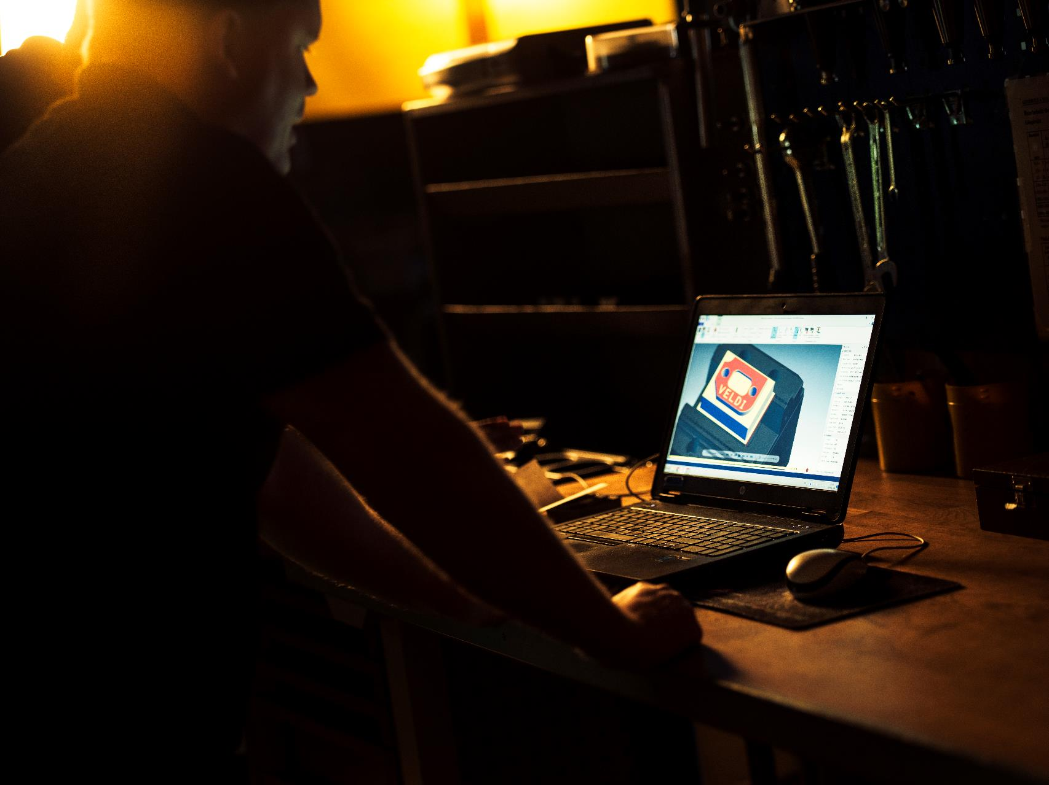


Slide 2
Course outline
Week 1
Anaconda
Jupyter Notebook
Version control with Git
Week 2
Numpy Basics
Why is Numpy so powerful?
Broadcasting and functionalities
Images and Files
Week 3
Pandas
Data visualization
Analyzing your dataset
Cleaning data
Statistical Analysis
Week 4
Simulating a scenario: Pandemic
Creating the artificial scenario
The classes and functions
Generating a dataset
Week 5
Matplotlib
Different types of plots
Identifying spread patterns
Function representations in graphs
Showcase of future courses; Tensorflow, PyTorch, Machine Learning etc

Slide 3
Python 2B
Week 4, Part 1
-
Simulating scenarios and generating data

Slide 4
Why do we simulate scenarios?
Often obtaining large amounts of data might be hard whilst understanding the system and model behind it might be easier
Simulating a scenario is also a good way of verifying of how a model performs in comparison to reality; which variables are necessary? Why does the simulation differ?
Whilst real data is always considered better, learning to simulate scenarios can give a great educational understanding of working with real data (also really fun)

Slide 5
Examples;
Self driving cars
Creating building complexes
Understanding behaviour
Astrophysics (movement of planets etc)
There are a lot more but these are some of the more interesting ones

Slide 6
A bit of a forewarning
This week is a bit heavier on the coding side
You will be writing quite a bit of code which is probably a lot easier than previous weeks, but more extensive
In this week and next week we will combine knowledge that we have learnt about both numpy, pandas and matplotlib to generate the simulation

Slide 7
Python 2B
Week 4, Part 2
-
Simulating a Pandemic: The classes

Slide 8
Approach to simulating scenarios
When recreating reality in code the files often tend to get rather large and there is need for good structure
In many cases, including this one, we will be making use of Object Oriented Programming (OOP) which you might already be familiar with
In short; we are making use of classes to structure the code
For the assignment we will be simulating a pandemic and we will use two classes primarily; Person and Village

Slide 9
Introducing the class: Person
We will create a new class called Person which represents an individual in our village
A person will initially be able to have three states: sick, deceased or recovered (if neither we just don’t give it a name, quite often in virus models these people are referred to as Susceptible individuals)
To each person in our village things happen each day such as that they might get sick, recover or pass away. These are things we will simulate

Slide 10
Introducing the class: Village
The second class we will be using is called Village
Village represents the town in where a small population of Persons live
A Person is just a Person but a village consists of hundreds of Persons
For the assignment we will just be working with one village, but if you want to you can create more
The Village class is the main component in the simulation, driving the days forward and keeping track on the community

Slide 11
A quick tip before we proceed
As mentioned this week will be quite a bit of coding and you will already be handed a pre-written script with the basics
Often when coding in real life you wont do things from scratch yourself. It is important to have a efficient way of approaching foreign code
Start with reading comments, class names and function names
Afterwards start at the main method and follow the calls being made. You can always make use of print statements to validate theories

Slide 12
Python 2B
Week 4, Showcase 1
Assignment 4:
-
Overview of the structure and OOP

Slide 13
Python 2B
Week 4, Part 3
-
Simulating a Pandemic: The interactions

Slide 14
Simulating interactions: Introduction
What you just saw in the showcase was a light walkthrough of how the code works
We did not go into the nitty and gritty of things as it might be good to give some explanation beforehand
It is quite common to make use of probabilities to represent real observations. Statistical analysis is very common and can be applied to nearly everything.
In this weeks assignment we will be using probabilities to represent interactions between individuals, chance of being infected and more!

Slide 15
Simulating interactions: Example 1
Example; In a group of 20 people one person sick. Apparently there is about 20-30% chance of the sickness spreading. How many individuals will get sick?
To simplify this for coding and not having to work with distributions we can say average chance is 25%
The amount of people becoming sick should therefore be 0.25 * 20, i.e 5.
Converting percentages into decimals are very common and we will be using it quite a lot

Slide 16
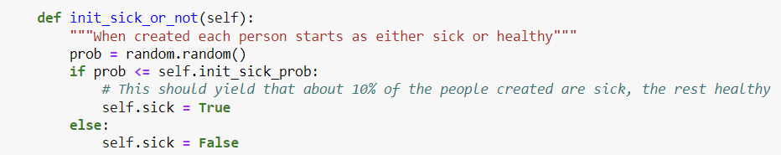
Simulating Interactions: Example 2
Below we have a method that can be found in the Person class. When creating a new person that person is set to sick or false depending on how the coin flips
Self.init_sick_prob here represents 0.1 or 10%, meaning a randomized number such as prob should be <= 0.1 in 1/10 cases

Slide 17
Things not included currently; but fun
There is not a whole lot of special interactions apart from virus spread
If you want to continue building on the assignment which I highly encourage you could create a map using a two dimensional numpy array
Here for example you can implement distance between individuals which decides how the virus spreads
Other ideas is to make things more realistic by adding things like isolation, tracking of the virus etc

Slide 18
Python 2B
Week 4, Showcase 2
Assignment 4:
-
Probabilities and deep dive

Slide 19
Python 2B
Week 4, Part 4
-
Simulating a Pandemic: The simplifications

Slide 20
Simplifications in terms of modelling
If you google the concept of virus spread you will most likely encounter the super popular SIR model (Susceptible Infected Recovered)
Whilst it is often the go to for describing pandemics in simplified terms it contains some troublesome mathematics if you are not used to it
Therefore we used a heavily inspired but not identical model which is made in simpler terms (Heavily recommended to read up on the model though!)

Slide 21
Simplifications in terms of spreading
As the first part of the assignment you will code the part that allows the virus to spread
In the assignment we simply say that a person encounter 10 people a day on average and it just so appears that about 5% of the people a sick individual meets gets infected, meaning about every 20th person.
This sort of makes sense and it does not. There are a lot of things that goes into spread like distance between individuals, length of exposure and more. We simplify this a lot

Slide 22
Simplifications on being sick and recovered
Currently being sick there is a chance of you getting better each day but the sickness itself and this process is not fully realistic
Same goes for recovering from the virus, we calculate currently that once recovered you become immune. Also not fully realistic

Slide 23
Python 2B
Week 4, Showcase 3
Assignment 4:
-
Generating the data

Slide 24
Python 2B
Week 4, Part 5
-
A rundown of what YOU will do in this weeks assignment

Slide 25
You will
Modify the classes; Person and Village
Add functionalities such as spread, vaccination and tracking of how long individuals have been sick
Work with simulation mechanics such as a day passing, time flow and data generation
In the end the goal is to use our simulated data to experiment with in next week using numpy and create our own data set

Slide 26
Useful resources
The Q/A:s each Wednesday/Thursday
The course teacher
Research the SIR model for some inspiration
Read up on Object Oriented Programming if needed, a lot of resources on the web
Stackoverflow
Numpy docs

Slide 27
Finally:
Simulating scenarios are often very interesting but also difficult. Reality often encompasses thousands if not millions more datapoints than we can describe in a simulation; the importance is in measuring what is the most relevant to include
There is a lot more you can do with the assignment once you are done, and I encourage you to! It is a lot of fun and inspiring to work with your own simulated data and compare to reality

Slide 28
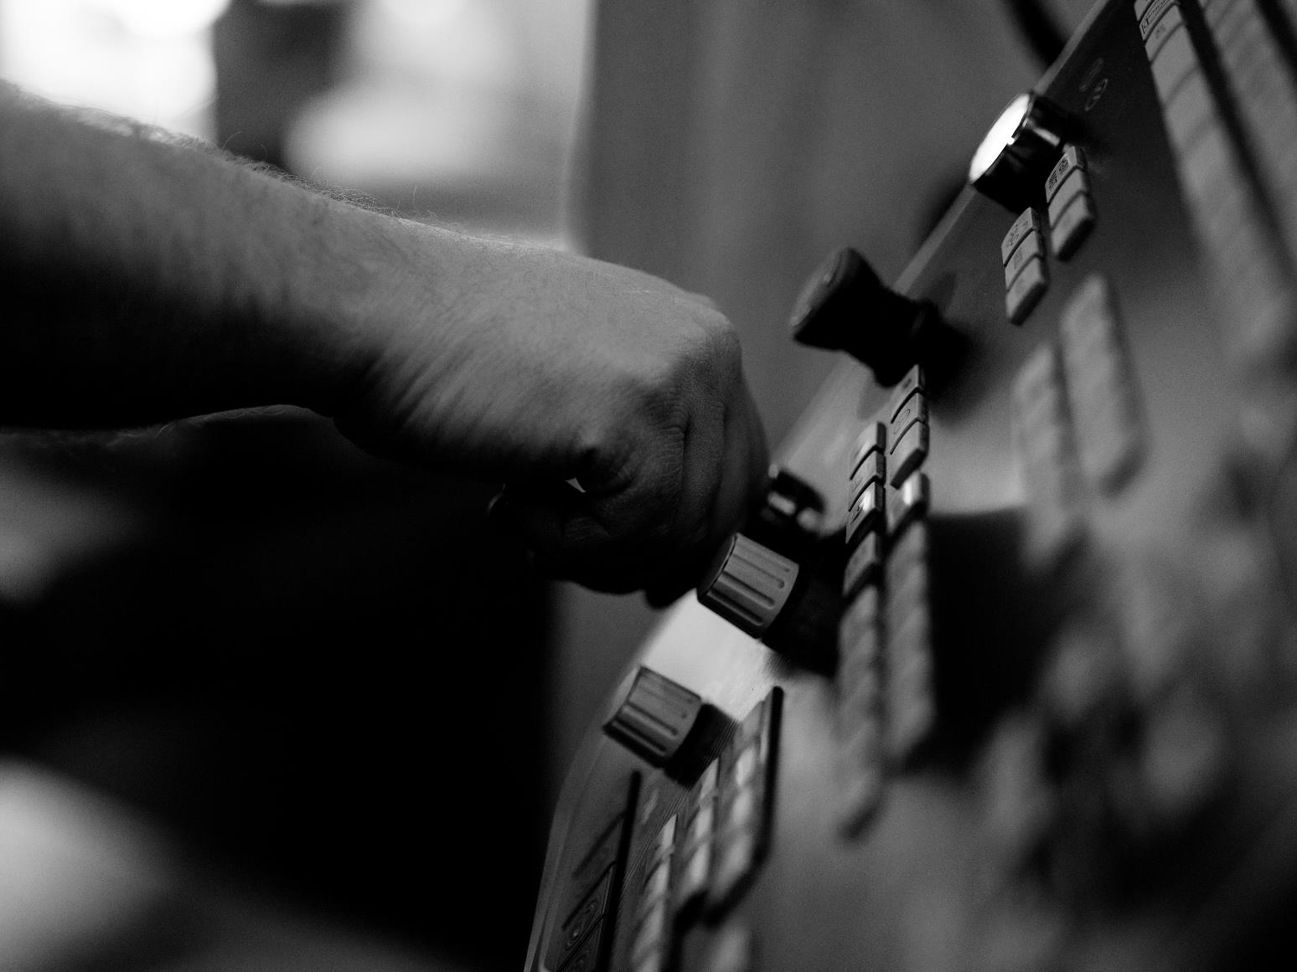
veldikompetens.se
Thank you!

